Slide 1
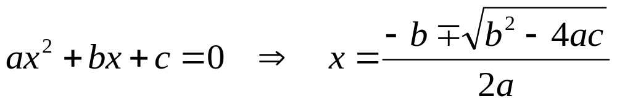
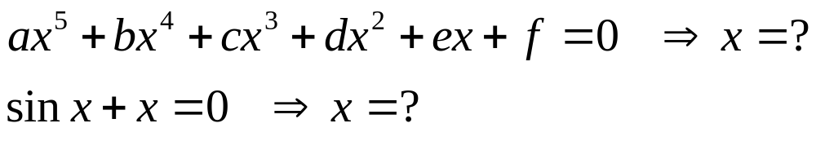
Part 2
Roots of Equations
Why?
But

Slide 2
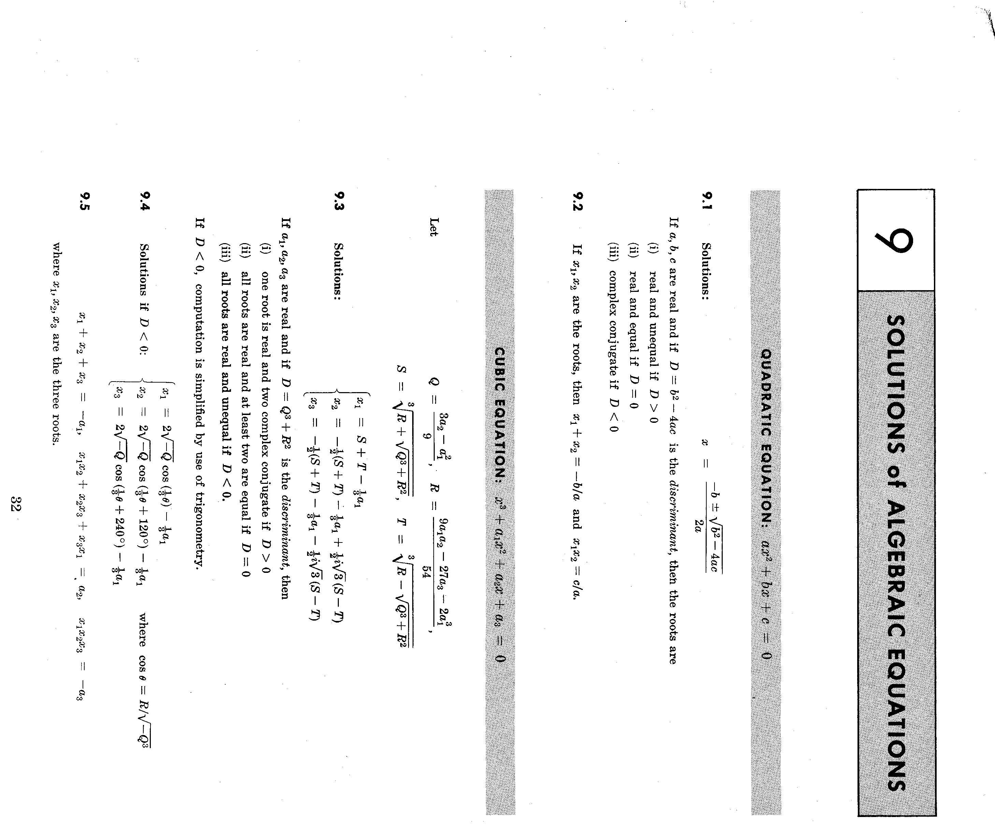

Slide 3
Nonlinear Equation
Solvers
Bracketing
Graphical
Open Methods
Bisection
False Position
(Regula-Falsi)
Newton Raphson
Secant
All Iterative

Slide 4
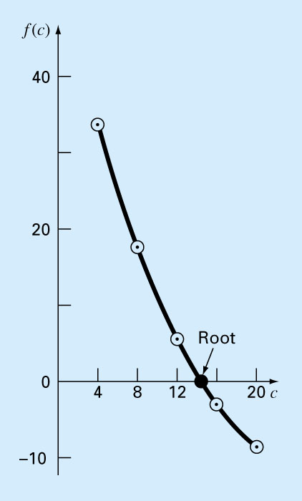
Chapter 5
Bracketing Methods
(Or, two point methods for finding roots)
Two initial guesses for the root are required. These guesses must “bracket” or be on either side of the root.
== > Fig. 5.1
If one root of a real and continuous function, f(x)=0, is bounded by values x=x_{l}, x =x_{u} then
f(x_{l}) . f(x_{u}) <0. (The function changes sign on opposite sides of the root)
Notes:
Insert Fig. 5.1 in here

Slide 5
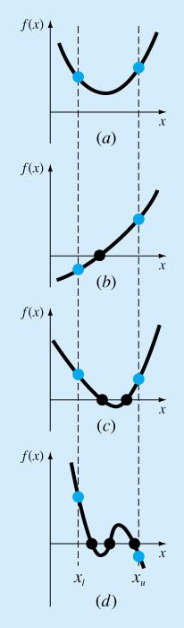
Figure 5.2

Slide 6
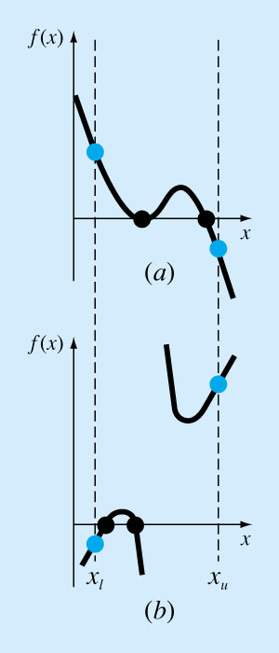
Figure 5.3

Slide 7
The Bisection Method
For the arbitrary equation of one variable, f(x)=0
Pick x_{l} and x_{u} such that they bound the root of interest, check if f(x_{l}).f(x_{u}) <0.
Estimate the root by evaluating f[(x_{l}+x_{u})/2].
Find the pair
  If f(x_{l}). f[(x_{l}+x_{u})/2]<0, root lies in the lower interval, then x_{u}=(x_{l}+x_{u})/2 and go to step 2.

Slide 8
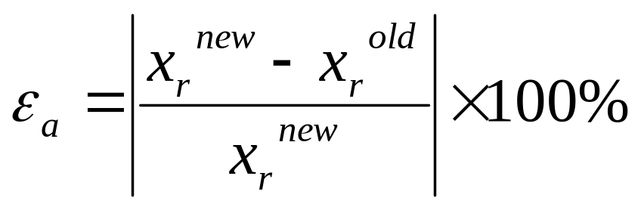
  If f(x_{l}). f[(x_{l}+x_{u})/2]>0, root lies in the upper interval, then x_{l}= [(x_{l}+x_{u})/2, go to step 2.
  If f(x_{l}). f[(x_{l}+x_{u})/2]=0, then root is (x_{l}+x_{u})/2 and terminate.
  Compare ε_{s} with ε_{a}
    (5.2, p. 118)
  If ε_{a}< ε_{s,} stop. Otherwise repeat the process.

Slide 9
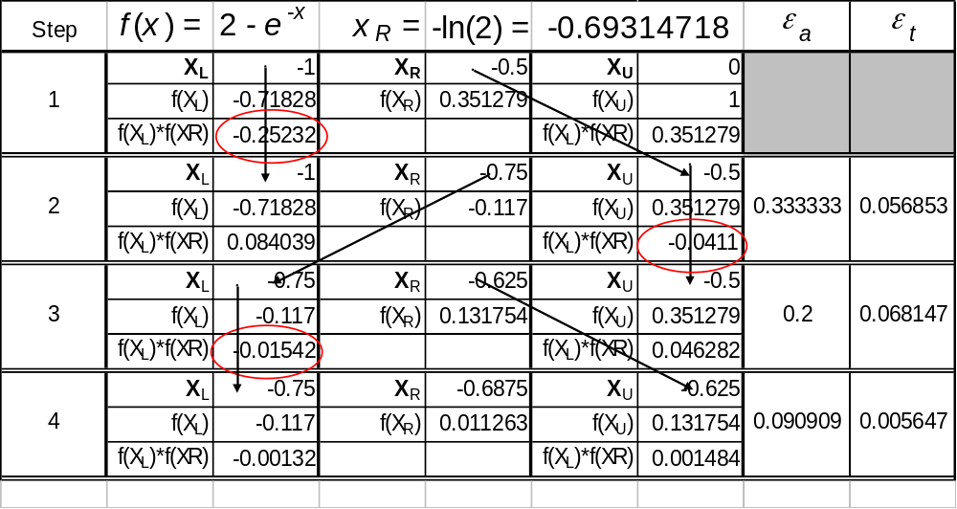

Slide 10
Evaluation of Method
Pros
Easy
Always find root
Number of iterations required to attain an absolute error can be computed a priori.
Cons
Slow
Know a and b that bound root
Multiple roots
No account is taken of f(x_{l}) and f(x_{u}), if f(x_{l}) is closer to zero, it is likely that root is closer to x_{l} .

Slide 11
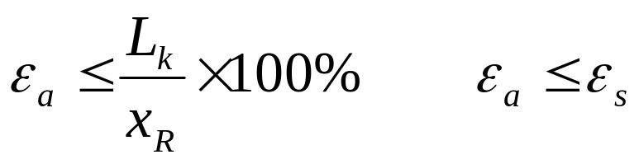
How Many Iterations will It Take?
Length of the first Interval L_{o}=b-a
After 1 iteration L₁=L_{o}/2
After 2 iterations L₂=L_{o}/4
After k iterations L_{k}=L_{o}/2^{k}

Slide 12
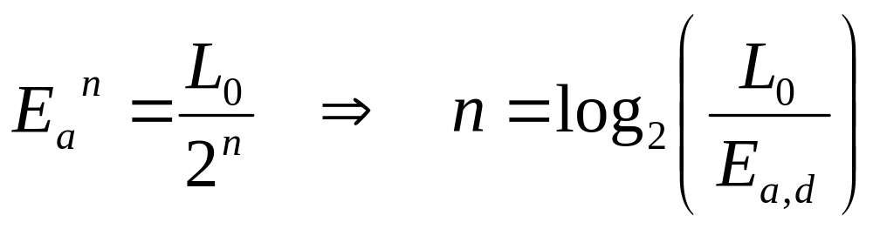
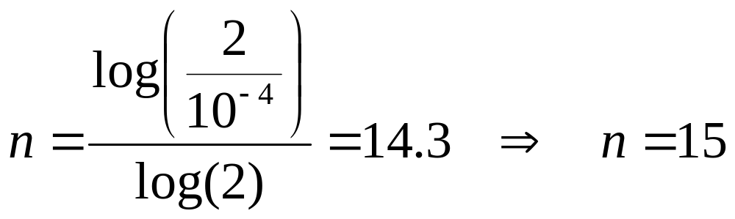
If the absolute magnitude of the error is
and L_{o}=2, how many iterations will you have to do to get the required accuracy = 10⁻⁴ in the solution?

Slide 13
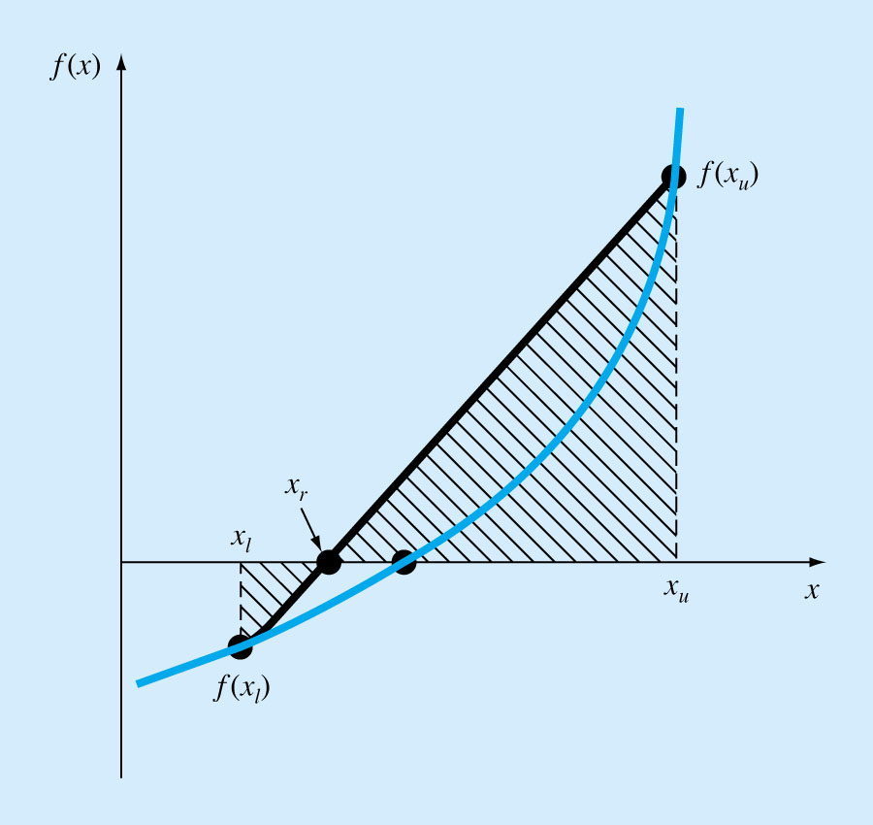
The False-Position Method
(Regula-Falsi)
If a real root is bounded by x_{l} and x_{u} of f(x)=0, then we can approximate the solution by doing a linear interpolation between the points [x_{l}, f(x_{l})] and [x_{u}, f(x_{u})] to find the x_{r} value such that l(x_{r})=0, l(x) is the linear approximation of f(x).
== > Fig. 5.12

Slide 14
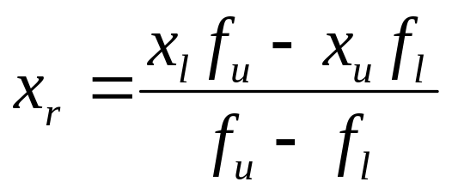
Procedure
Find a pair of values of x, x_{l} and x_{u} such that f_{l}=f(x_{l}) <0 and f_{u}=f(x_{u}) >0.
Estimate the value of the root from the following formula (Refer to Box 5.1)
and evaluate f(x_{r}).

Slide 15
Use the new point to replace one of the original points, keeping the two points on opposite sides of the x axis.
Use the same selecting rules as the bisection method.
If f(x_{r})=0 then you have found the root and need go no further.

Slide 16
See if the new x_{l} and x_{u} are close enough for convergence to be declared. If they are not go back to step 2.
Why this method?
  Usually faster
  Always converges for a single root.
  ➔See Sec.5.3.1, Pitfalls of the False-Position Method
  Note: Always check by substituting estimated root in the original equation to determine whether f(x_{r}) ≈ 0.
One-sidedness: Watch out (p. 128)

Slide 17
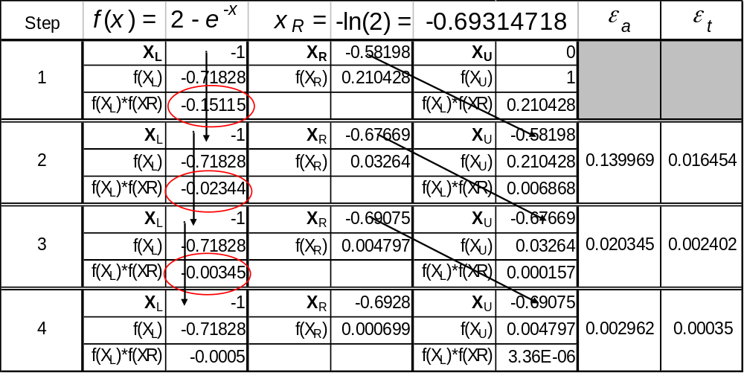

Slide 18
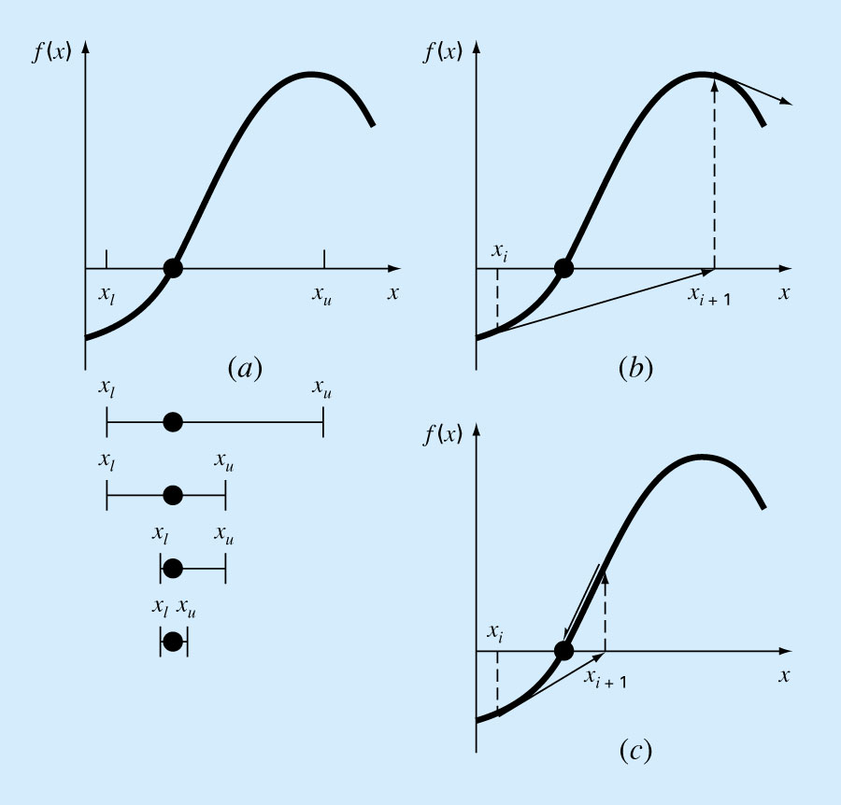
Chapter 6
Open Methods
Figure 6.1
Open methods are based on formulas that require only a single starting value of x or two starting values that do not necessarily bracket the root.

Slide 19
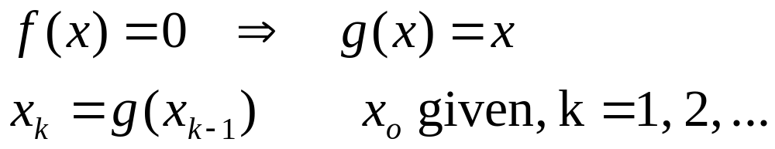
Simple Fixed-point Iteration
Rearrange the function so that x is on the left side of the equation:
Bracketing methods are “convergent”.
Fixed-point methods may sometime “diverge”, depending on the stating point (initial guess) and how the function behaves.
Good for calculators.

Slide 20
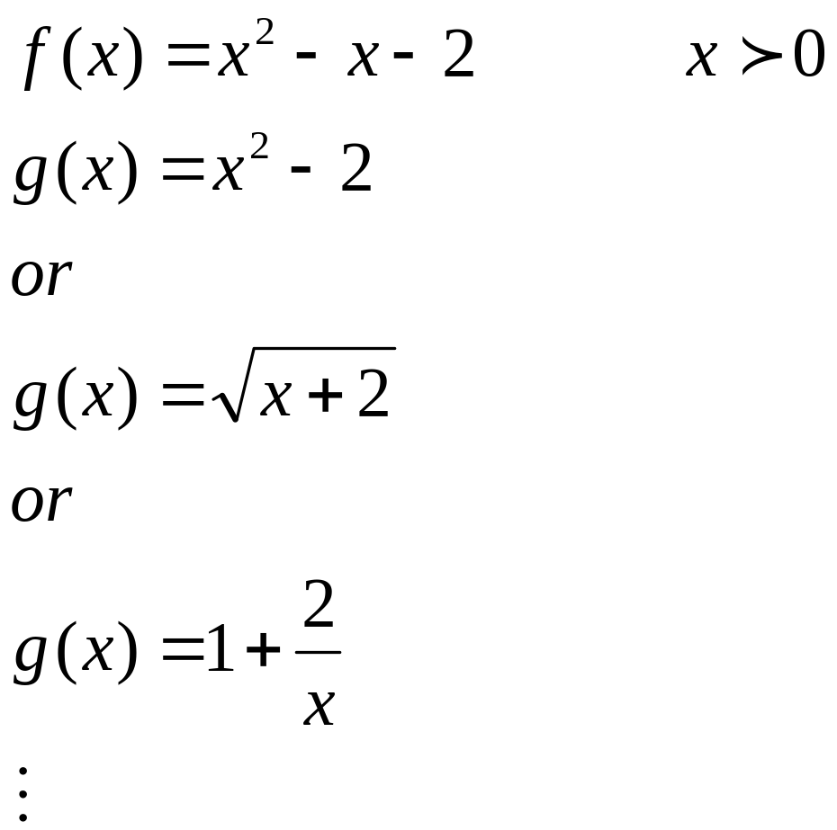
Example:

Slide 21
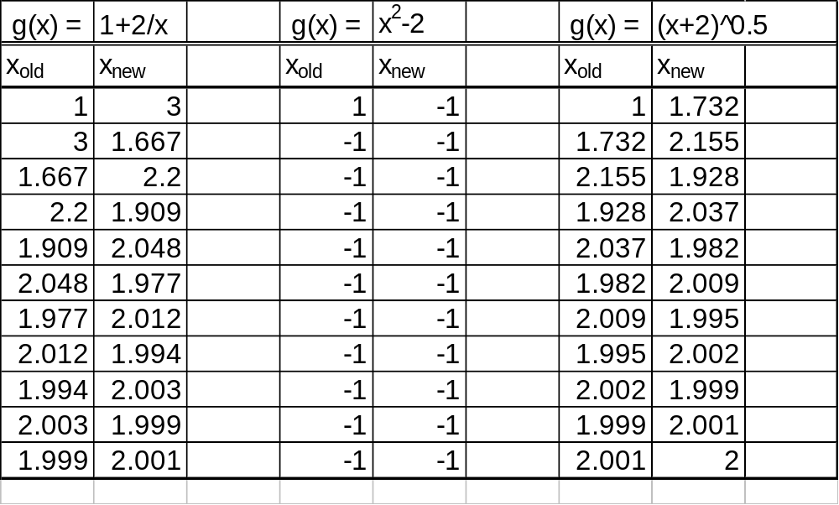

Slide 22
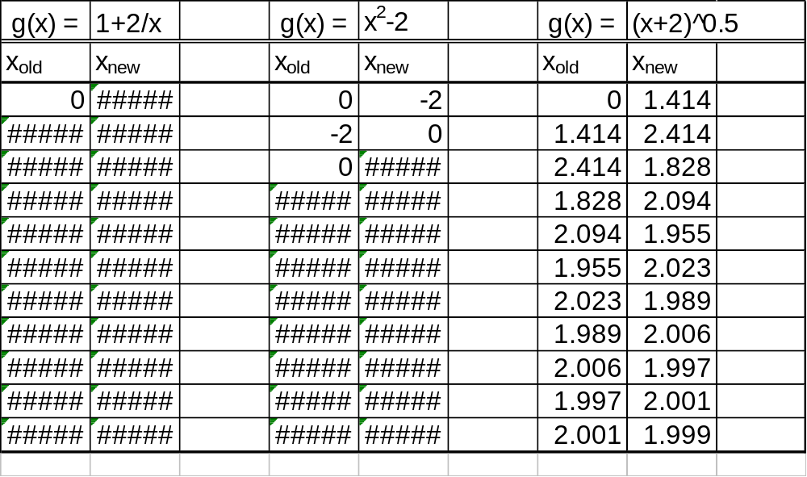

Slide 23
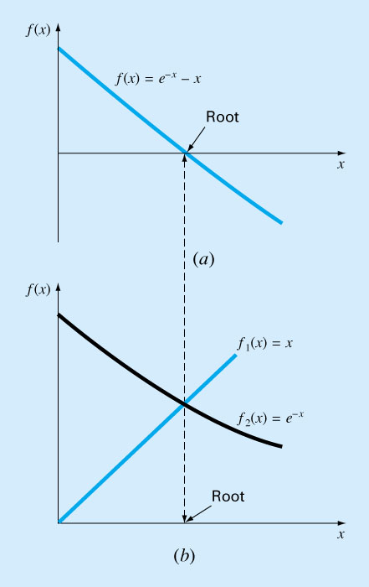
Convergence
Figure 6.2
x=g(x) can be expressed as a pair of equations:
y₁=x
y₂=g(x) (component equations)
Plot them separately.

Slide 24
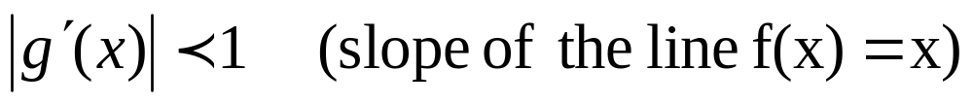
Conclusion
Fixed-point iteration converges if
When the method converges, the error is roughly proportional to or less than the error of the previous step, therefore it is called “linearly convergent.”

Slide 25
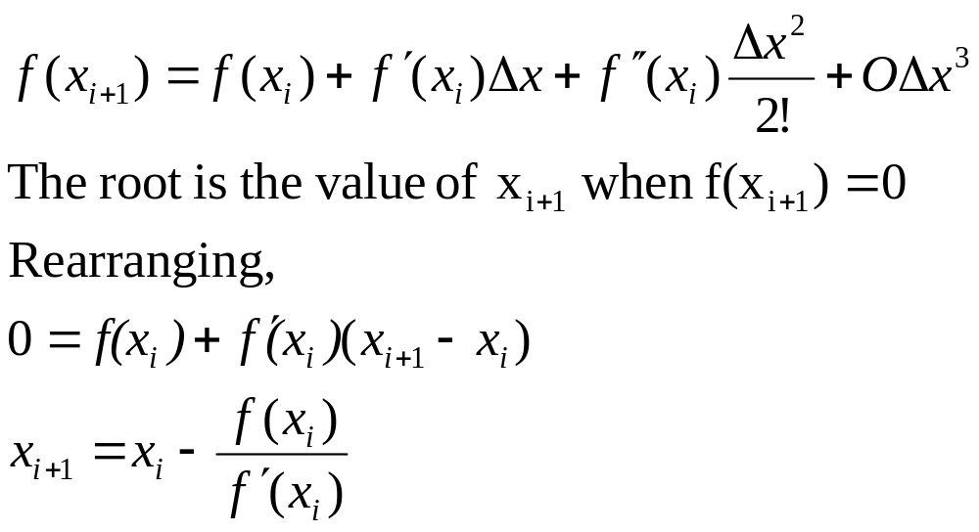
Newton-Raphson Method
Most widely used method.
Based on Taylor series expansion:
Solve for
Newton-Raphson formula

Slide 26
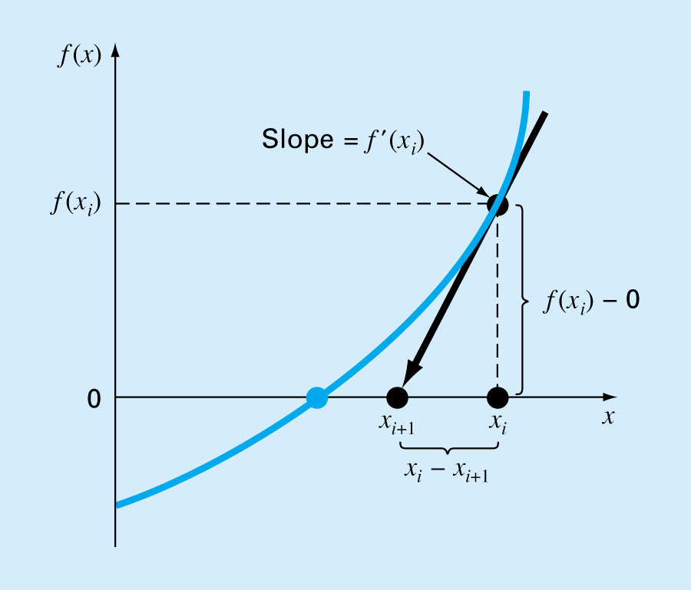
Fig. 6.5
A convenient method for functions whose derivatives can be evaluated analytically. It may not be convenient for functions whose derivatives cannot be evaluated analytically.

Slide 27
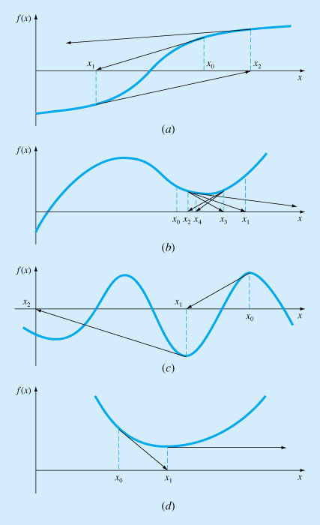
Fig. 6.6

Slide 28
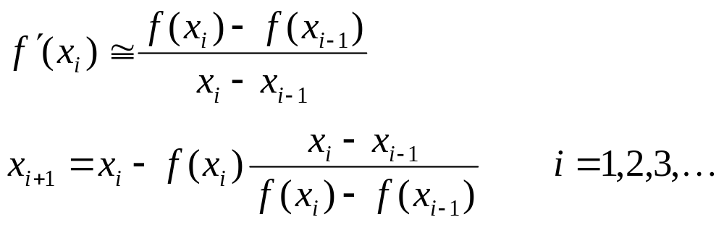
The Secant Method
A slight variation of Newton’s method for functions whose derivatives are difficult to evaluate. For these cases the derivative can be approximated by a backward finite divided difference.

Slide 29
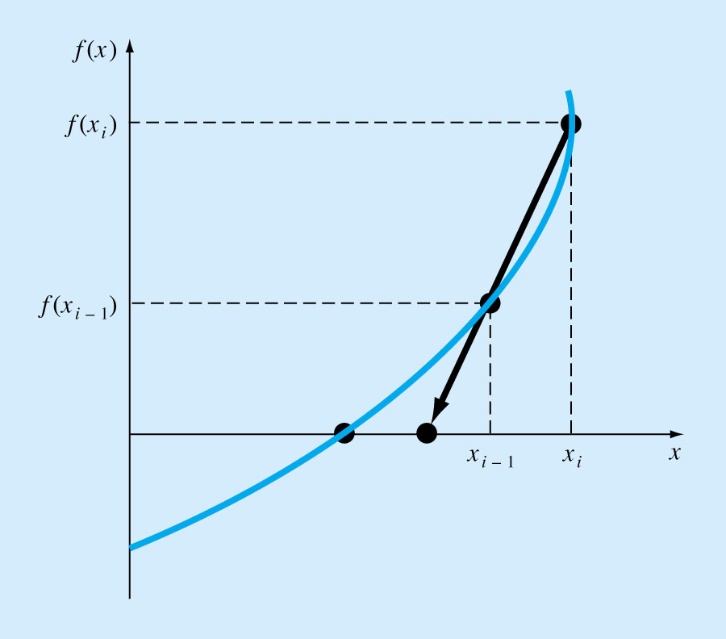
Fig. 6.7
  Requires two initial estimates of x , e.g, x_{o}, x₁. However, because f(x) is not required to change signs between estimates, it is not classified as a “bracketing” method.
  The scant method has the same properties as Newton’s method. Convergence is not guaranteed for all x_{o}, f(x).

Slide 30
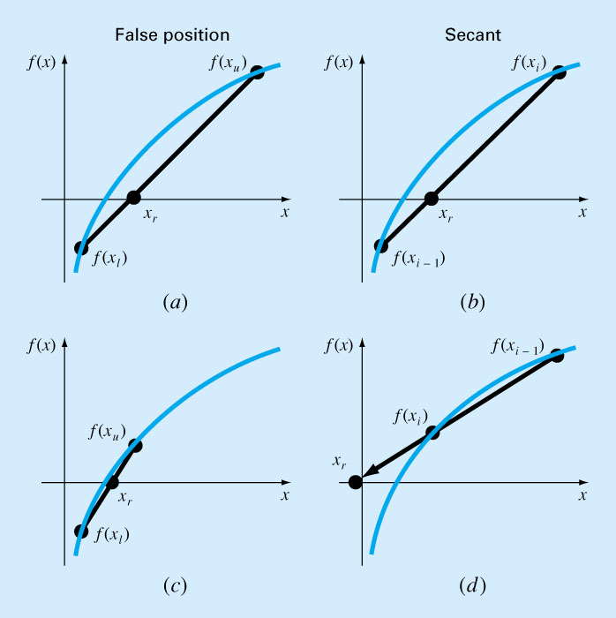
Fig. 6.8

Slide 31
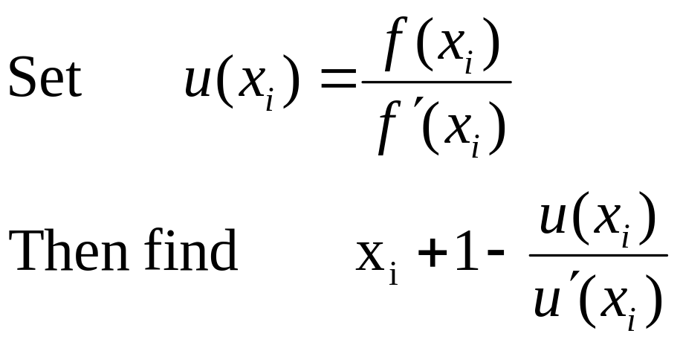
Multiple Roots
None of the methods deal with multiple roots efficiently, however, one way to deal with problems is as follows:
This function has roots at all the same locations as the original function

Slide 32
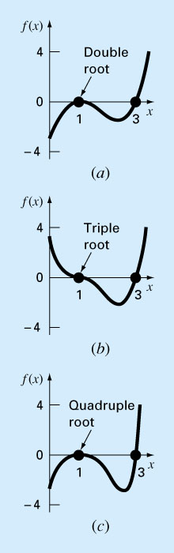
Fig. 6.10

Slide 33
“Multiple root” corresponds to a point where a function is tangent to the x axis.
Difficulties
  Function does not change sign at the multiple root, therefore, cannot use bracketing methods.
  Both f(x) and f′(x)=0, division by zero with Newton’s and Secant methods.

Slide 34
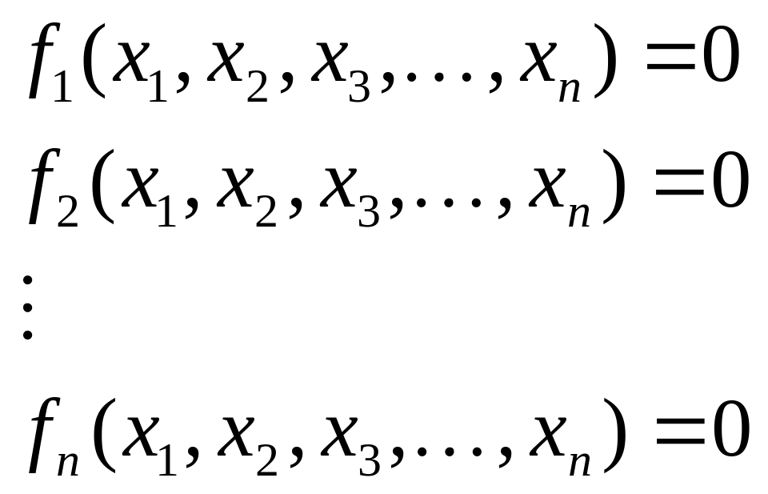
Systems of Linear Equations

Slide 35
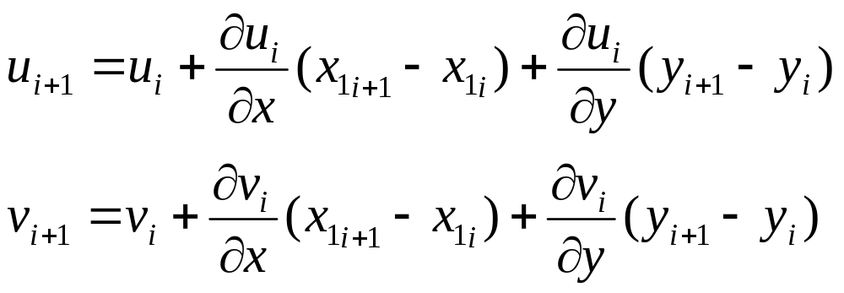
Taylor series expansion of a function of more than one variable
The root of the equation occurs at the value of x and y where u_{i+1} and v_{i+1} equal to zero.

Slide 36
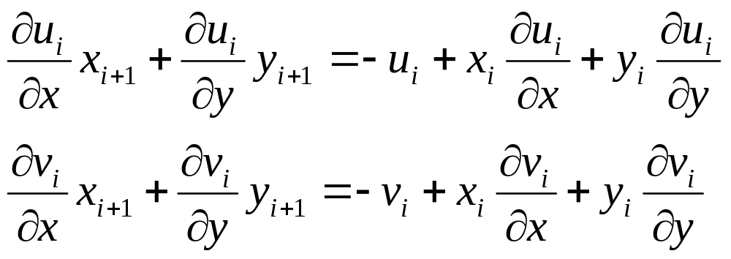
A set of two linear equations with two unknowns that can be solved for.

Slide 37
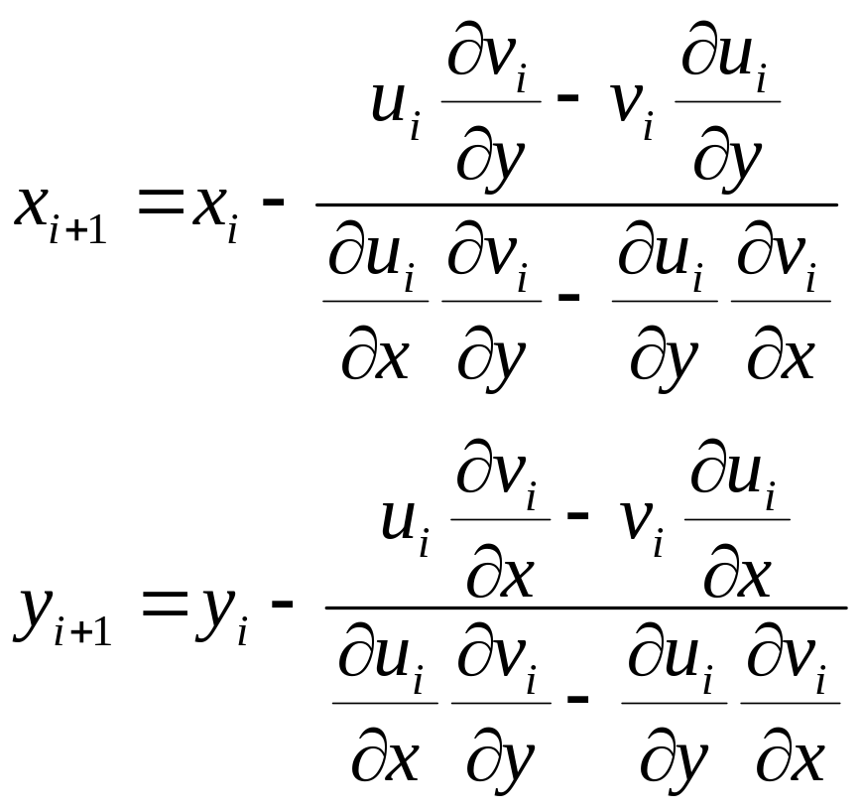
Determinant of the Jacobian of the system.

Slide 38
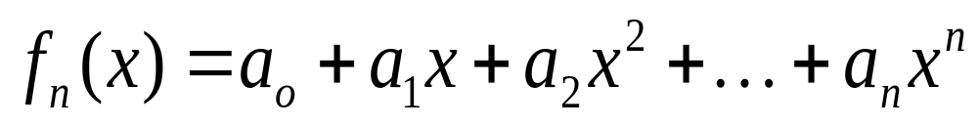
Chapter 7
Roots of Polynomials
The roots of polynomials such as
Follow these rules:
For an nth order equation, there are n real or complex roots.
If n is odd, there is at least one real root.
If complex root exist in conjugate pairs (that is, λ+μi and λ-μi), where i=sqrt(-1).

Slide 39
Conventional Methods
The efficacy of bracketing and open methods depends on whether the problem being solved involves complex roots. If only real roots exist, these methods could be used. However,
  Finding good initial guesses complicates both the open and bracketing methods, also the open methods could be susceptible to divergence.
Special methods have been developed to find the real and complex roots of polynomials – Müller and Bairstow methods.

Slide 40
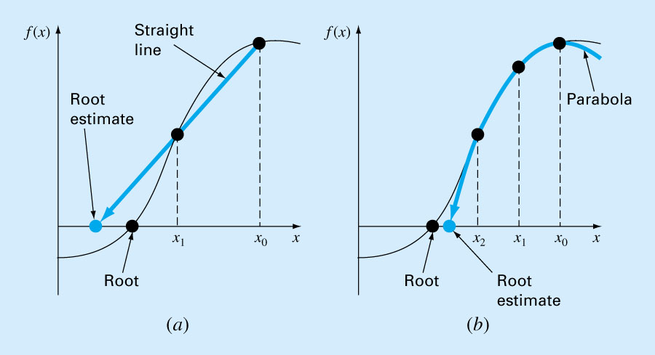
Müller Method
Müller’s method obtains a root estimate by projecting a parabola to the x axis through three function values.
Figure 7.3

Slide 41
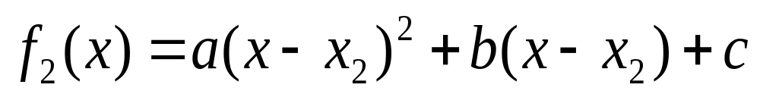
Müller Method
The method consists of deriving the coefficients of parabola that goes through the three points:
  1. Write the equation in a convenient form:

Slide 42
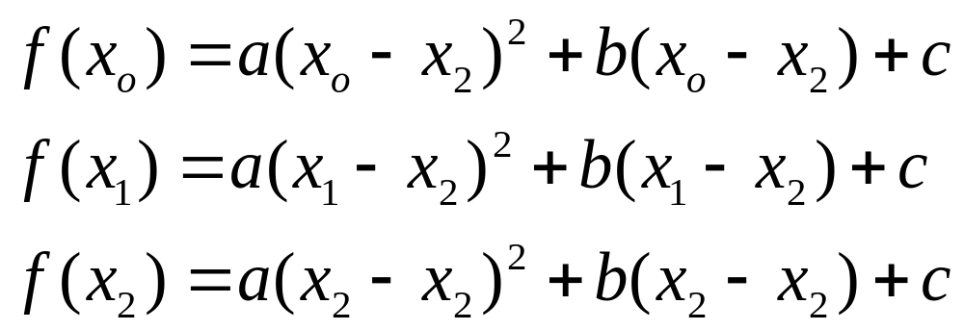
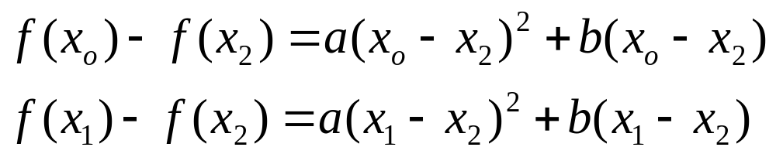
  The parabola should intersect the three points [x_{o}, f(x_{o})], [x₁, f(x₁)], [x₂, f(x₂)]. The coefficients of the polynomial can be estimated by substituting three points to give
  Three equations can be solved for three unknowns, a, b, c. Since two of the terms in the 3rd equation are zero, it can be immediately solved for c=f(x₂).

Slide 43
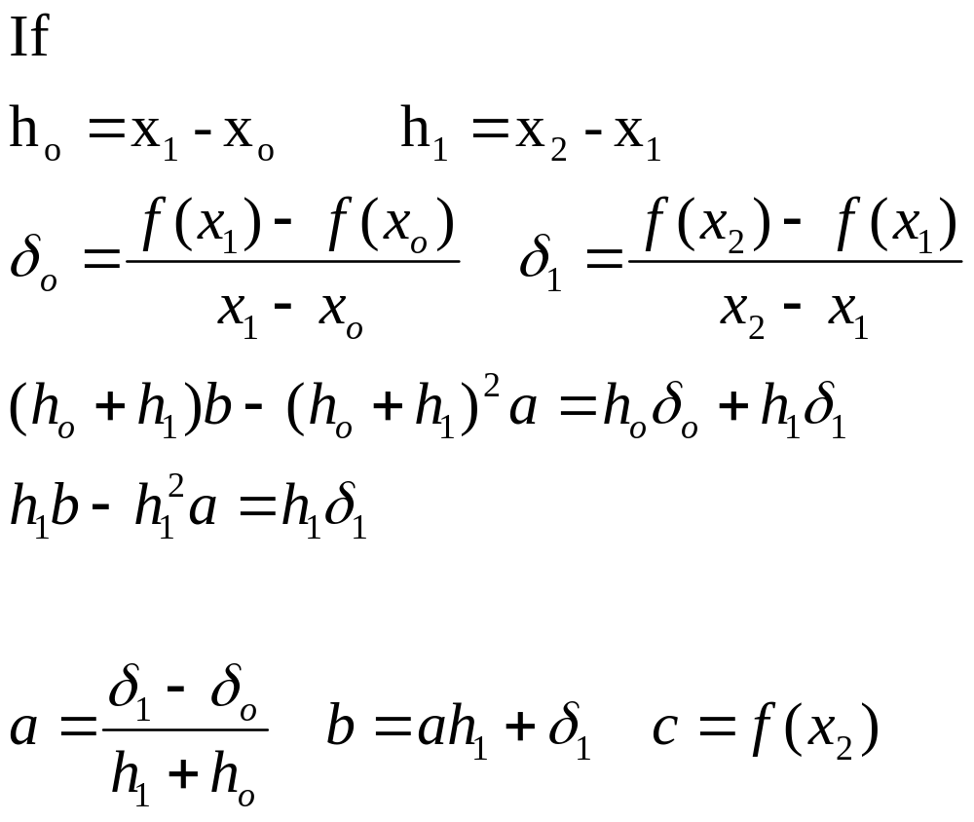
Solved for a and b

Slide 44
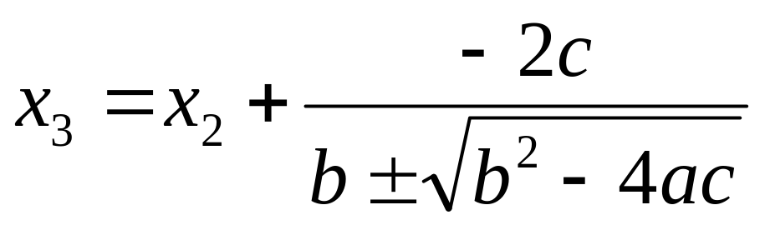
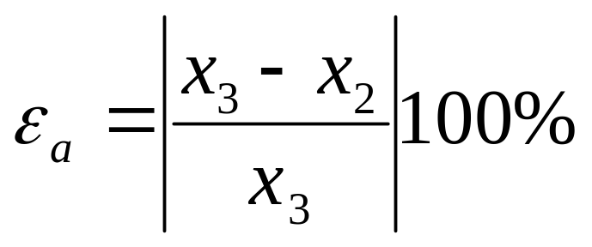
Roots can be found by applying an alternative form of quadratic formula:
The error can be calculated as
±term yields two roots, the sign is chosen to agree with b. This will result in a largest denominator, and will give root estimate that is closest to x₂.

Slide 45
Once x₃ is determined, the process is repeated using the following guidelines:
  If only real roots are being located, choose the two original points that are nearest the new root estimate, x₃.
  If both real and complex roots are estimated, employ a sequential approach just like in secant method, x₁, x₂, and x₃ to replace x_{o}, x₁, and x₂.

Slide 46
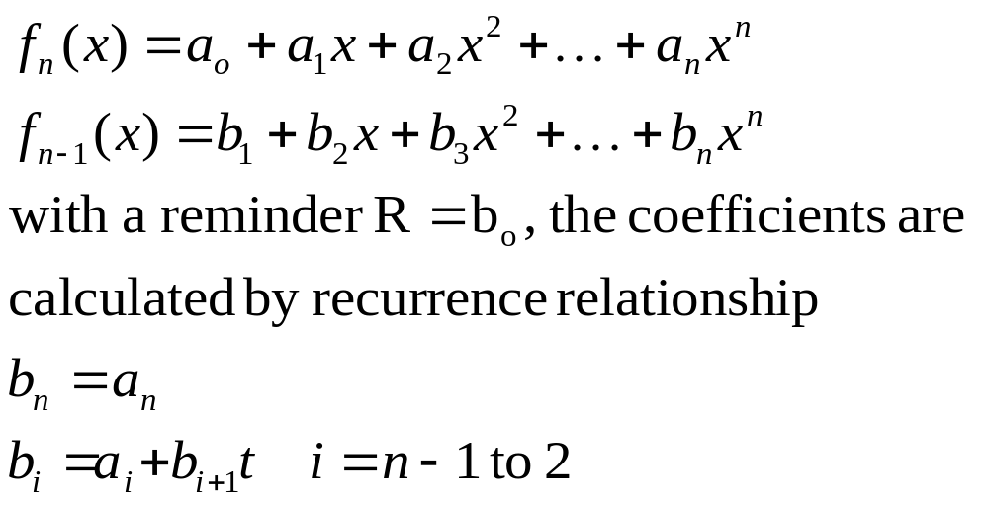
Bairstow’s Method
Bairstow’s method is an iterative approach loosely related to both Müller and Newton Raphson methods.
It is based on dividing a polynomial by a factor x-t:

Slide 47
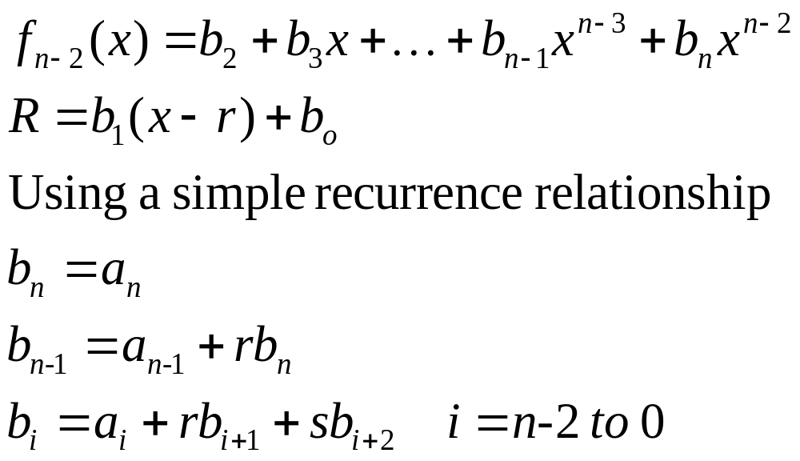
To permit the evaluation of complex roots, Bairstow’s method divides the polynomial by a quadratic factor x²-rx-s:

Slide 48
For the remainder to be zero, b_{o} and b₁ must be zero. However, it is unlikely that our initial guesses at the values of r and s will lead to this result, a systematic approach can be used to modify our guesses so that b_{o} and b₁ approach to zero.
Using a similar approach to Newton Raphson method, both b_{o} and b₁ can be expanded as function of both r and s in Taylor series.

Slide 49
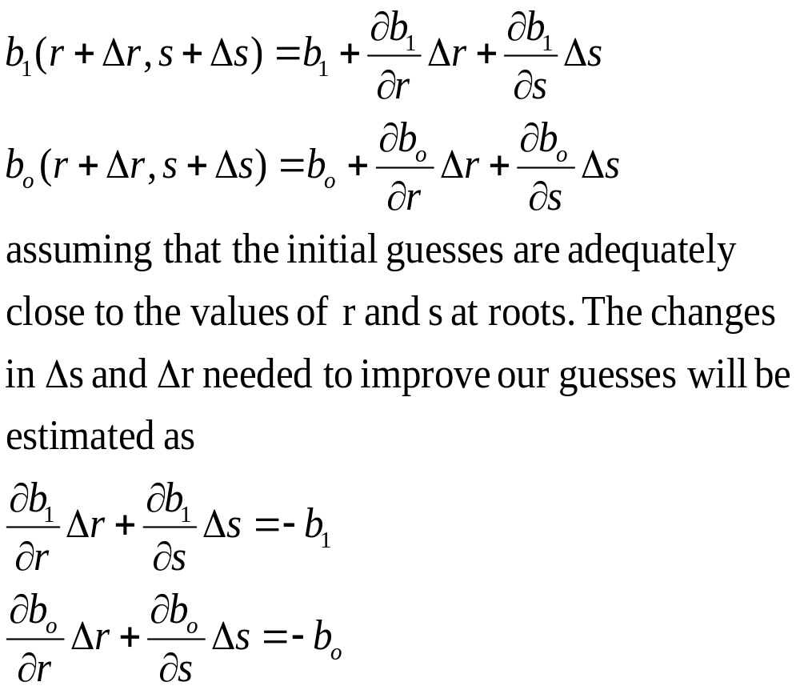

Slide 50
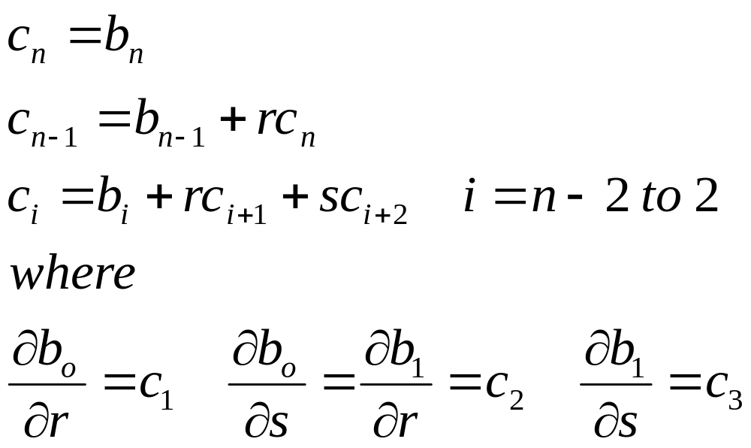
If partial derivatives of the b’s can be determined, then the two equations can be solved simultaneously for the two unknowns Δr and Δb.
Partial derivatives can be obtained by a synthetic division of the b’s in a similar fashion the b’s themselves are derived:

Slide 51
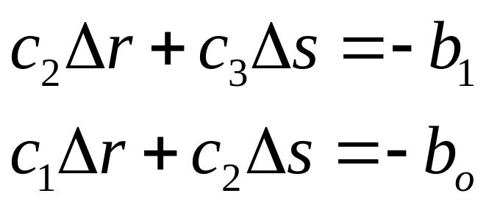
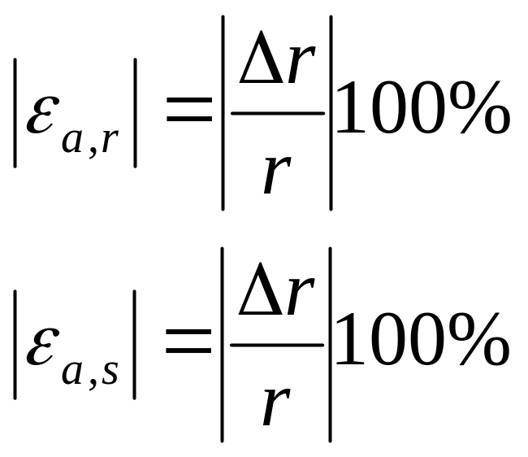
Then
At each step the error can be estimated as
Solved for Δr and Δs, in turn are employed to improve the initial guesses.

Slide 52
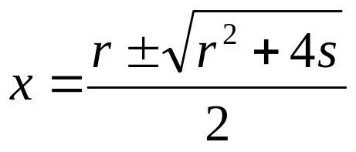
  The values of the roots are determined by
At this point three possibilities exist:
  The quotient is a third-order polynomial or greater. The previous values of r and s serve as initial guesses and Bairstow’s method is applied to the quotient to evaluate new r and s values.
  The quotient is quadratic. The remaining two roots are evaluated directly, using the above eqn.
  The quotient is a 1st order polynomial. The remaining single root can be evaluated simply as x=-s/r.
Refer to Tables pt2.3 and pt2.4

